Slide 1
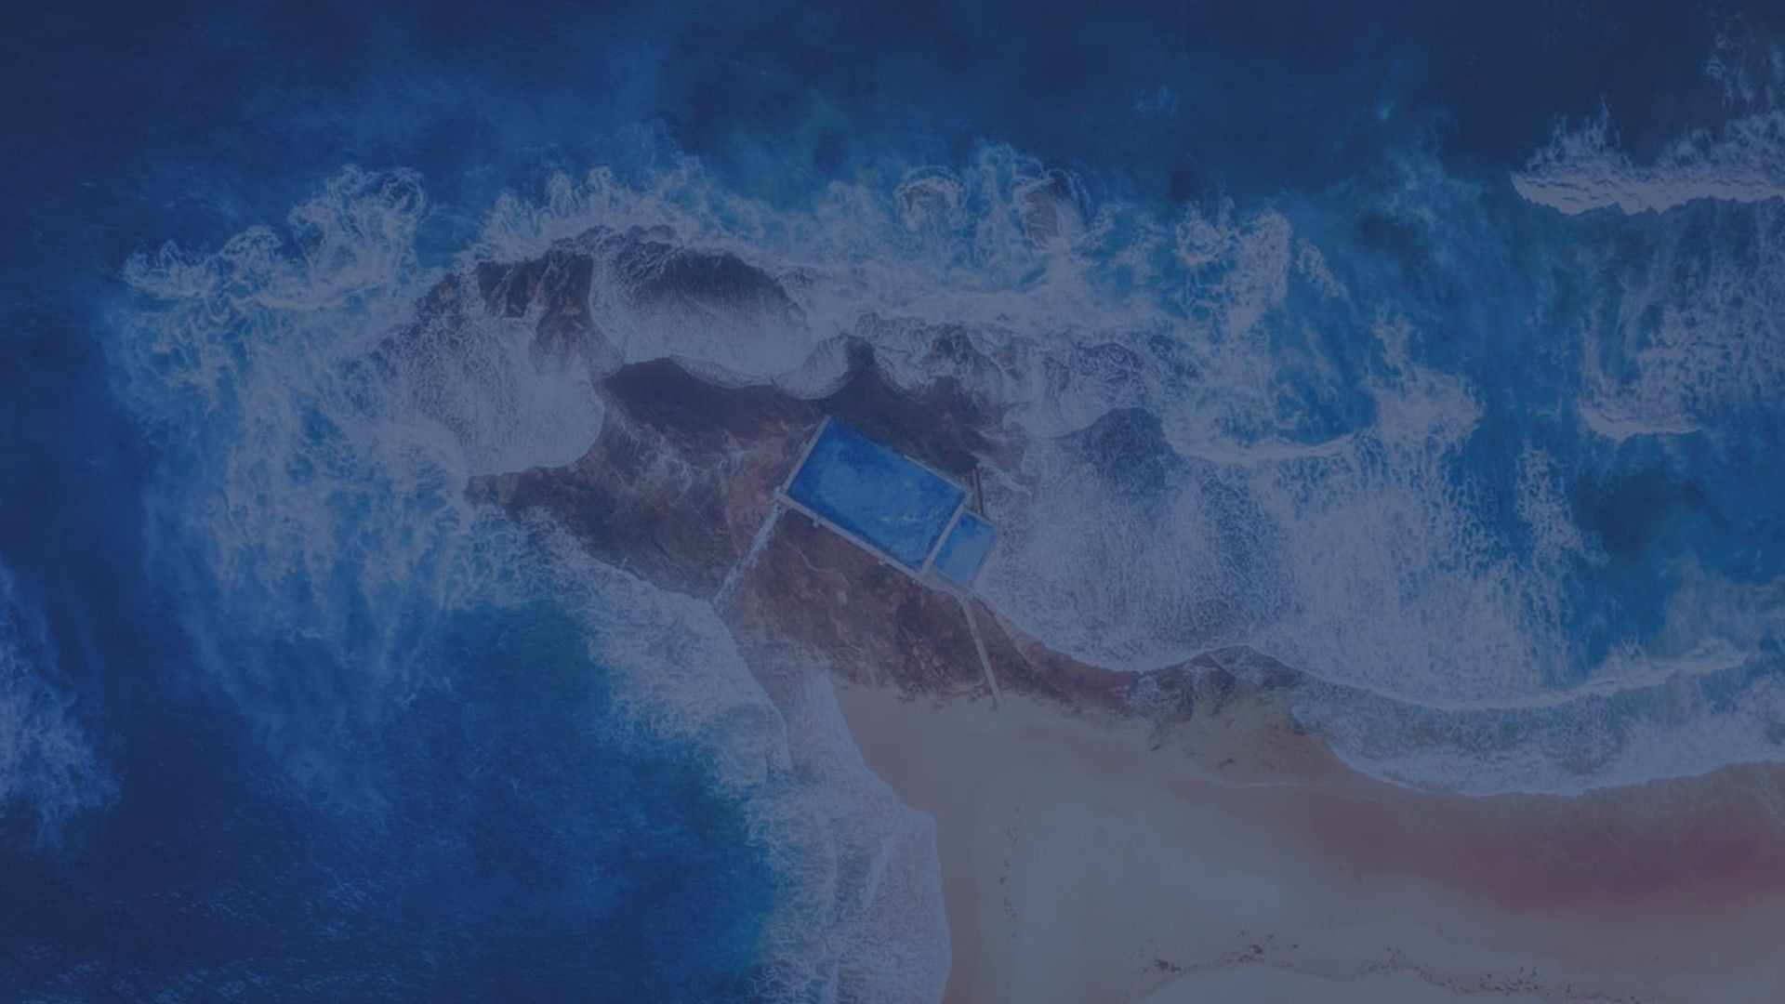
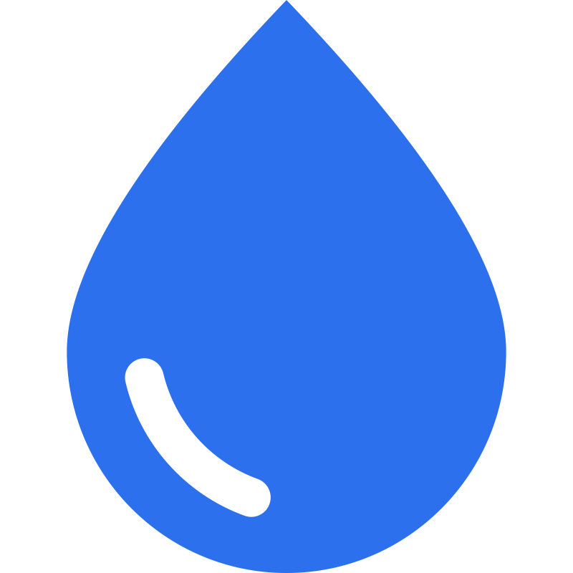
Potable Water
Supervision Platform
Corporation
Bank of China

Slide 2
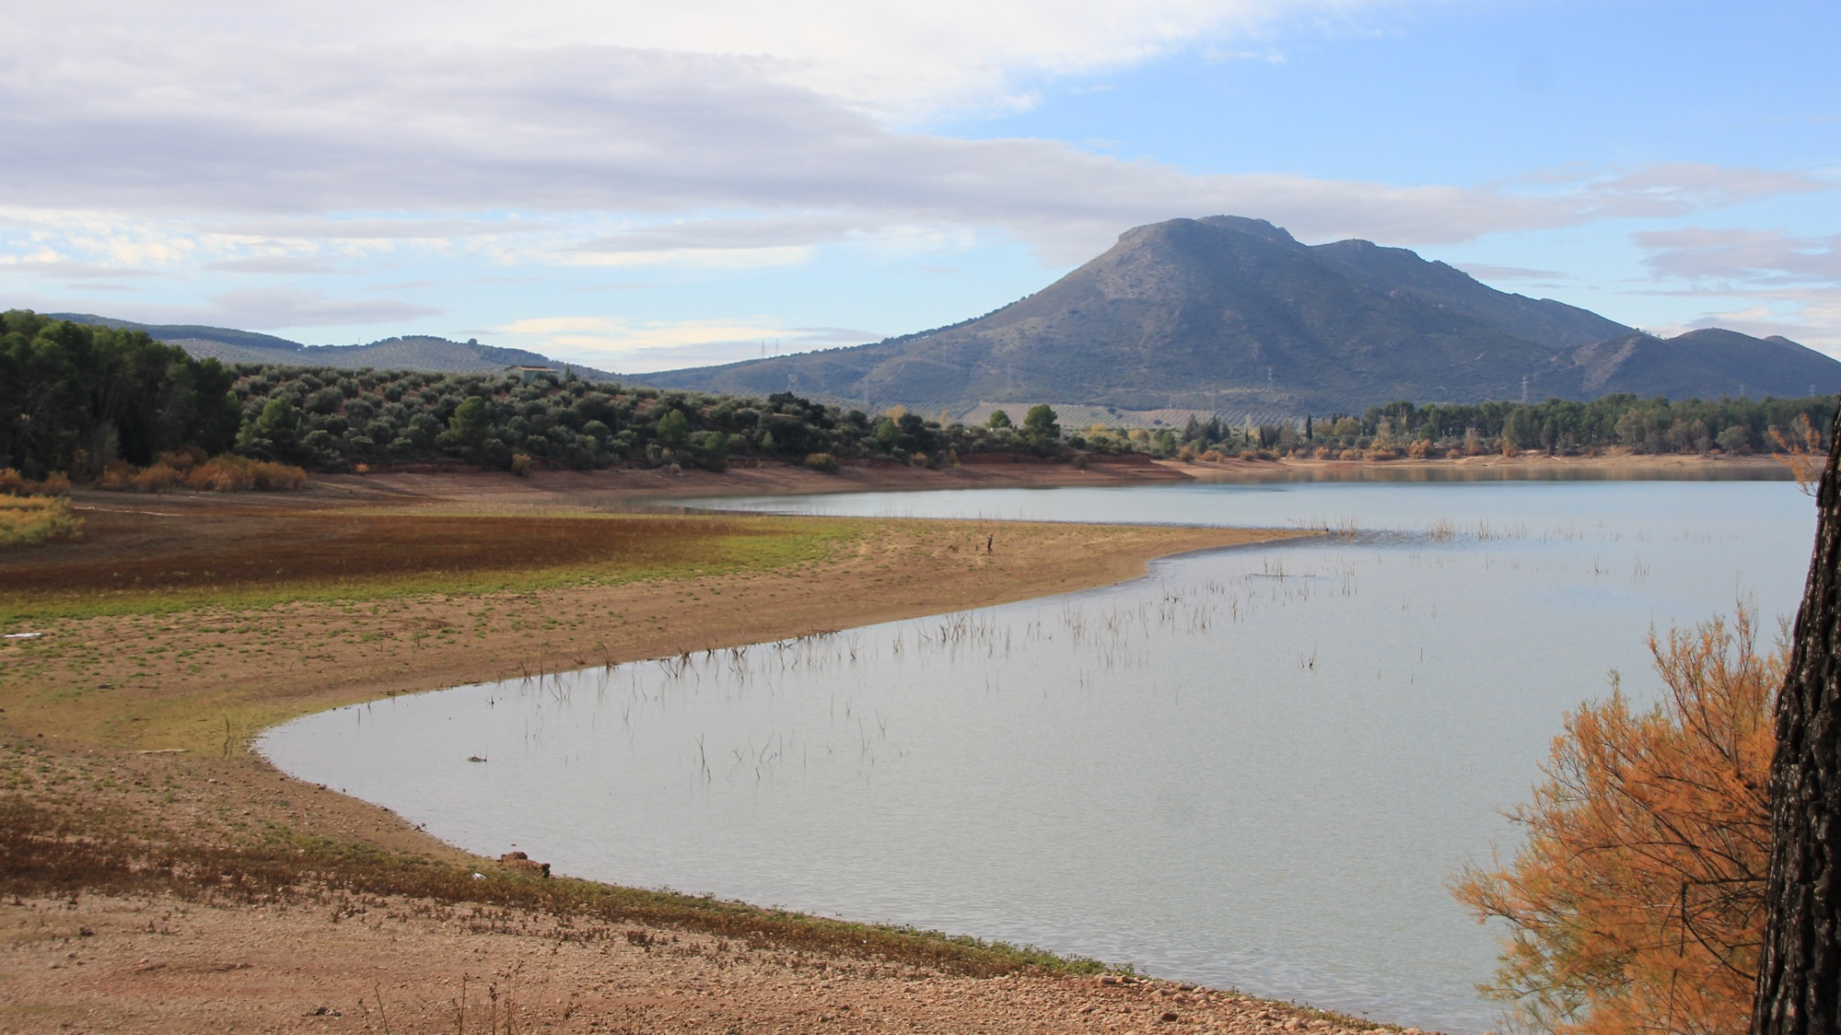






Global water quality problems
Every Year，due to water pollution
50 million people die !
90 million people suffer from hepatitis !!
35 million people suffer from cardiovascular disease !!!
30 million people die of liver cancer and gastric cancer !!!!
70 million people suffer from gallstones and kidney stones !!!!!
A large amount of capital investment is needed to improve the potable water problem. At the same time, the correct use of the invested funds requires full supervision and tracking.
2
Notes:
Throughout the world, about 1.5 billion people are short of fresh water. About 300 million people are extremely short of water and the water quality is not up to standard.

Slide 3
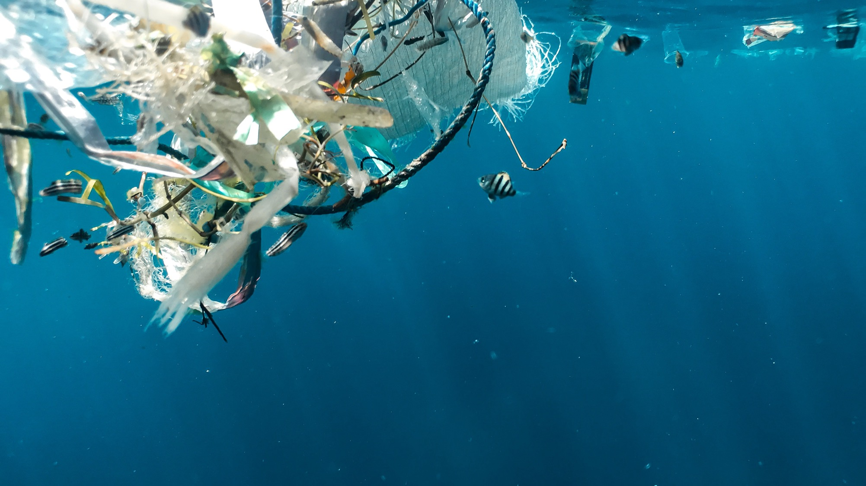

The story of a village
There has been a tall garbage mountain behind the village. People's potable water has been polluted due to highly toxic rotten items and filthy water infiltrating into the ground.
Consequently, a lot of human beings have died of cancer in this only-400-people village during past ten years, which was named“cancer village”by multiple media companies.
It has been proved that the quantity of TP, NH₃-N, CODcr and SS in the water of the village were exceeded severely. Has the following characteristics：
01
02
03
04
05
Multiple pollution sources [agricultural waste, chemical pollutants, domestic waste]
The treatment rate is low,
Lack of water treatment facilities;
Sewage is growing rapidly,
The output is increasing;
The emission is wide and scattered,
It is difficult to collect sewage;
The cost of centralized discharge network is high;
A large amount of funds is needed;
3

Slide 4

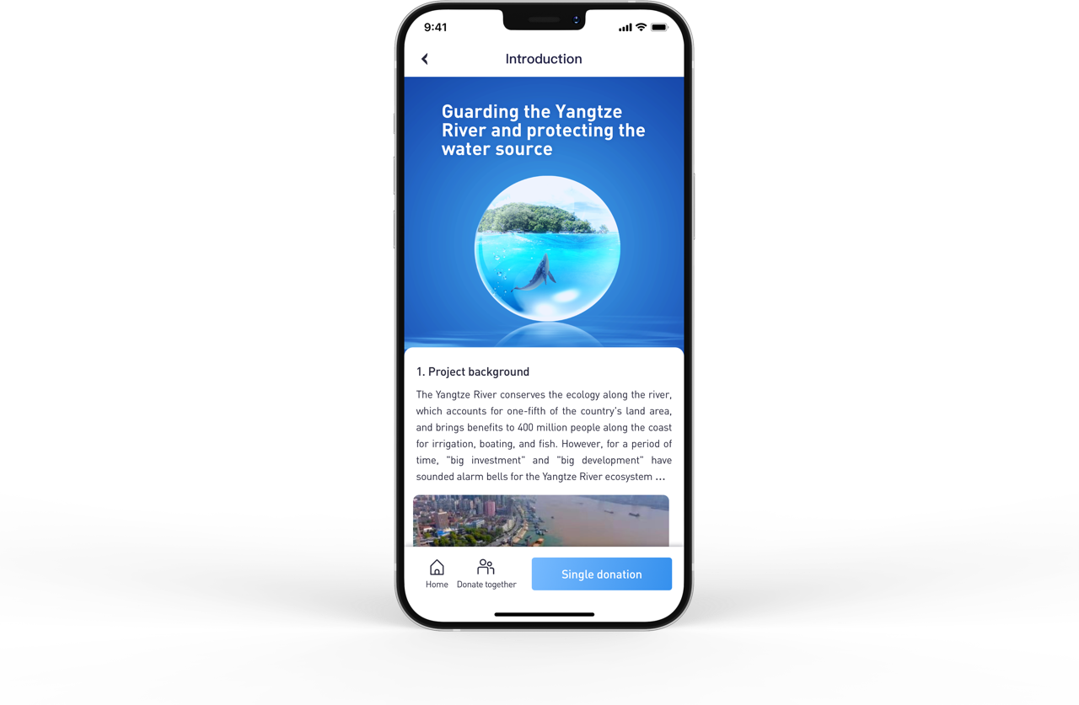

The story of a village
【Fundraising 1: Initiate donations】The local government is determined to improve the local water quality through contacting charity foundation.
【Fundraising 2: Apply for a loan】Through PPP Or BOT mode, water control enterprises should apply for green loans from banks and other financial institutions to treat sewage.
4

Slide 5
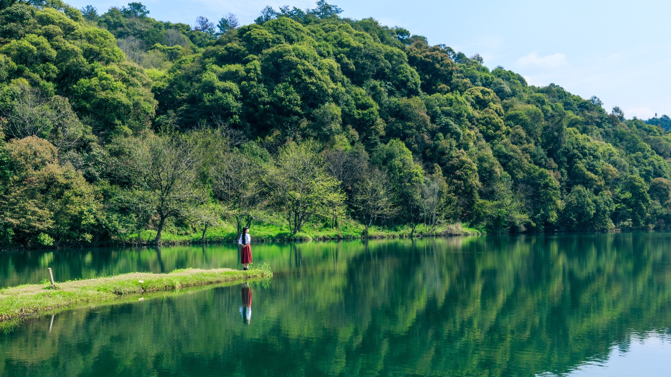

The story of a village
The local government and water control enterprises connect the platform where the total funds of the project are recorded for earmarked.
The water control enterprises apply for each fund through the platform which the transaction is also issued simultaneously. The smart contract will automatically check if the funds correspond the requirements. If not, a warning will be generated and the credit data will be recorded.
After several years, the water quality of the area has reached the national water standard , and the health of residents has been effectively improved.
5

Slide 6

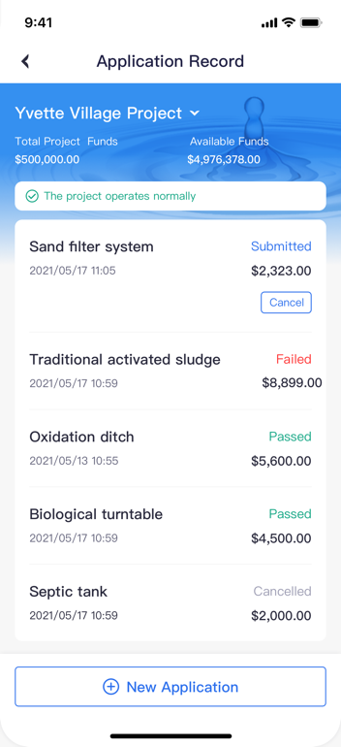
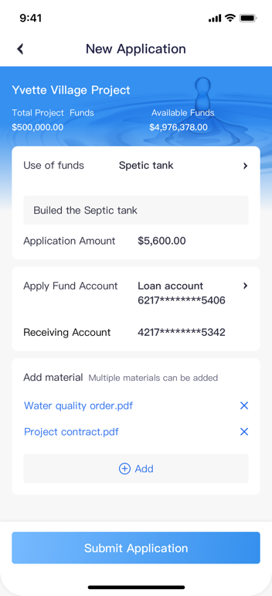
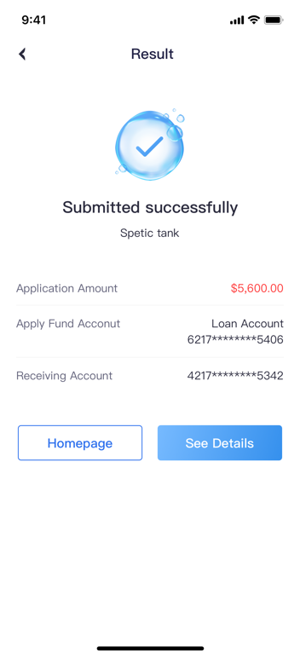
API of Potable Water Supervision Platform
API introduction
Enterprise users log in at APP
The water quality improvement projects are found
Application for additional funds
You can query the application records and status.
6

Slide 7

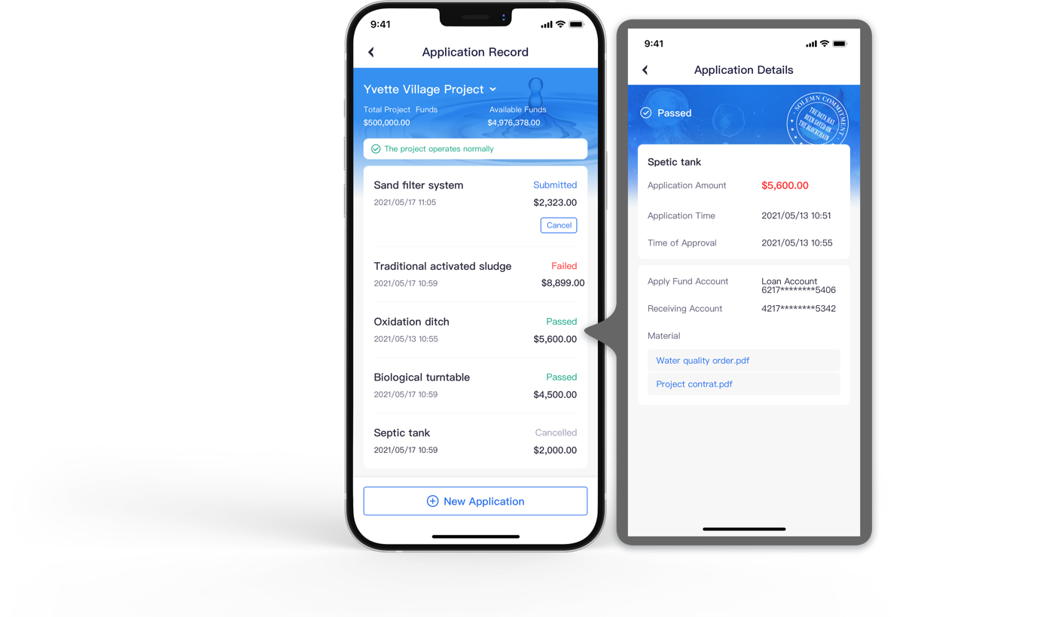
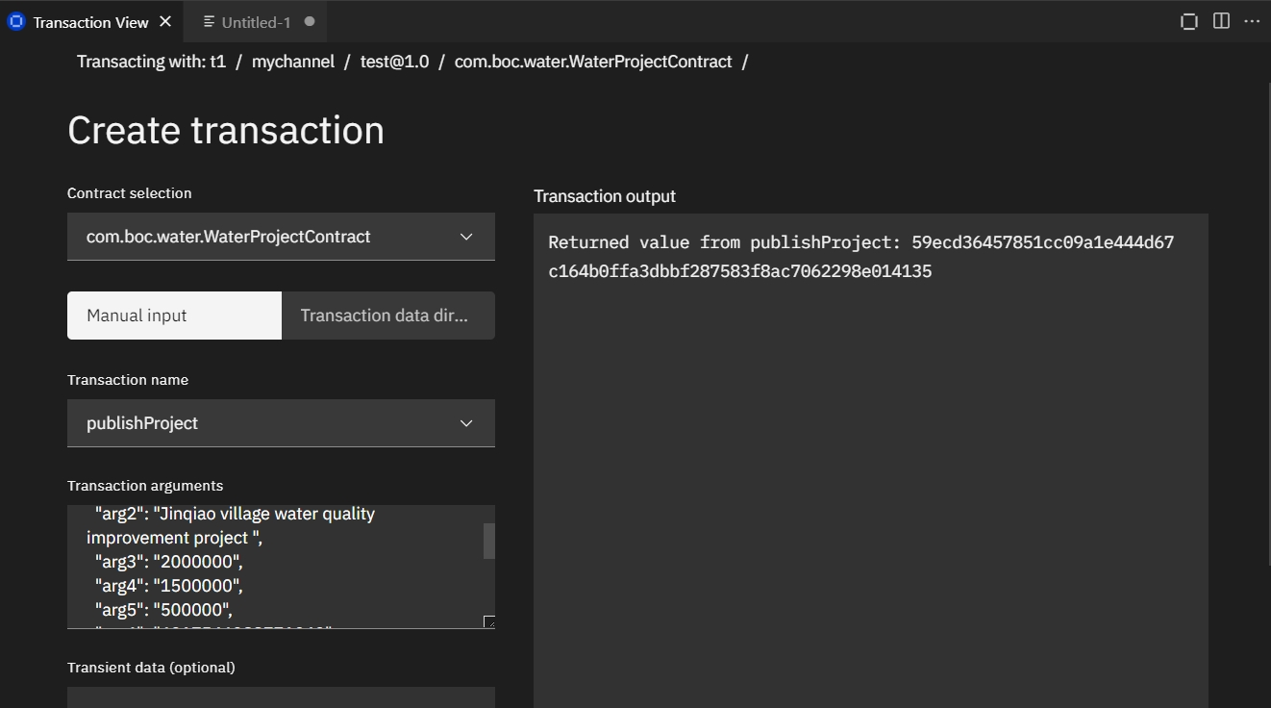
API of Potable Water Supervision Platform
The platform checks the use of funds:
If the application is approved, it will be written into the blockchain, and the user will query the application and it has passed;
If not, the reason for failure will be shown.
7

Slide 8
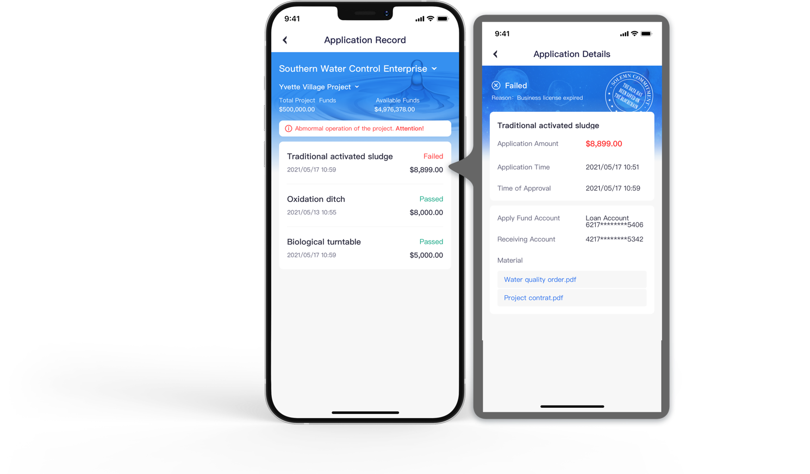
API of Potable Water Supervision Platform
Bank / NGO administrator:
Query the application records and status of the enterprise.
8

Slide 9
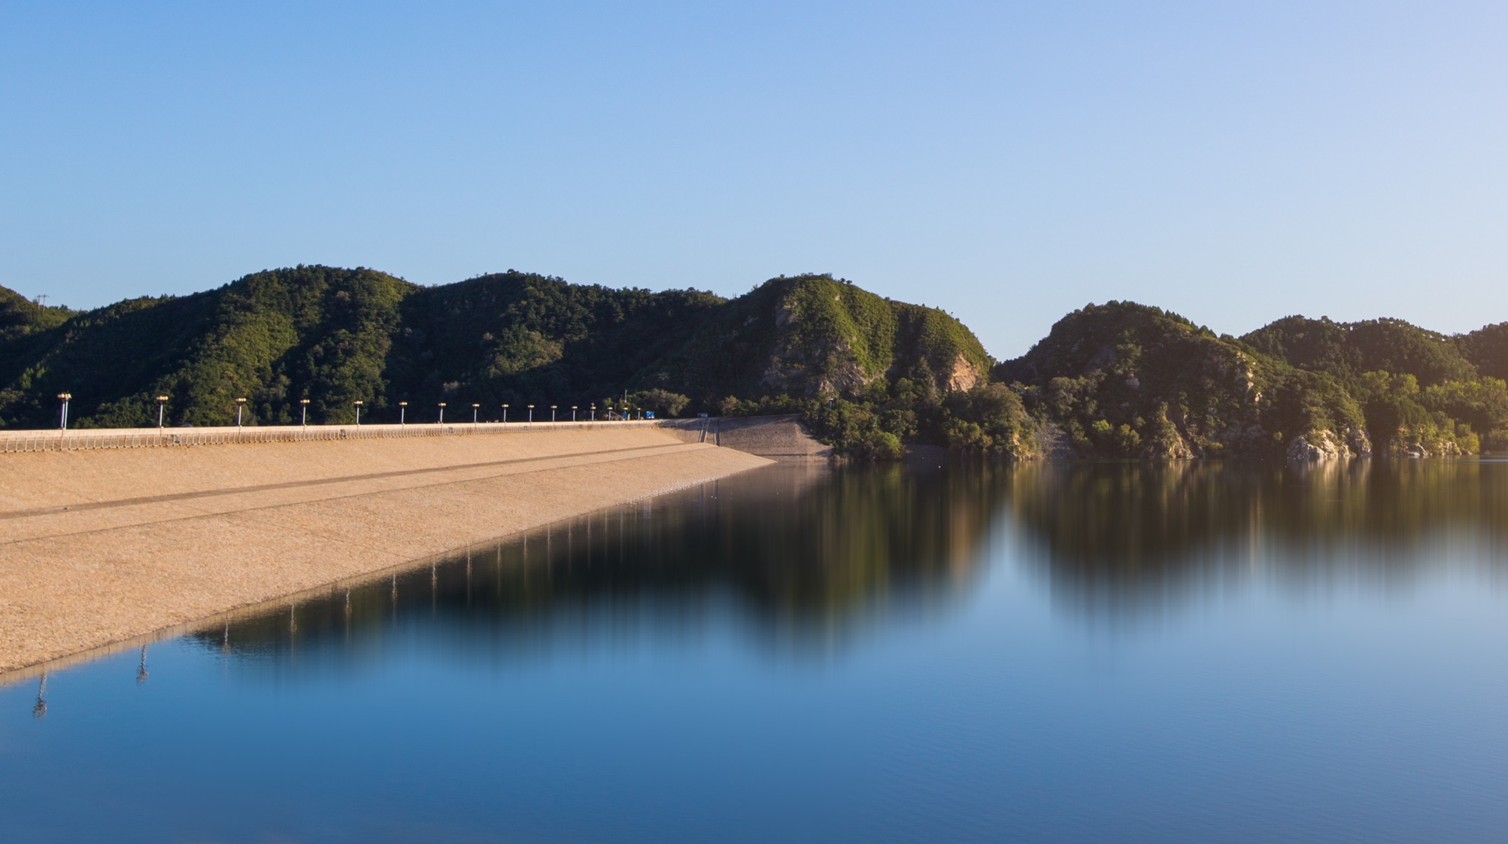
Solution framework
IBM Blockchain
IBM Container
Smart contract
Distributed ledger
IBM CLOUD
Fund usage check contract
Account fund ledger
Mobile apps
User access platform
Automatic transfer contract
fund use history ledger
Automatic alert contract
Alert history ledger
1、Based on IBM block chain, the whole platform realizes the alliance chain composed of financial institutions, enterprises, government and public welfare organizations;
2、 Smart contract ensures the timeliness of fund supervision, and monitors the illegal use and intelligent alarm;
3、Information asymmetry and trust problems across agents are solved through distributed ledger to ensure consistency of data.
9

Slide 10
System architecture
Query project information
/Initiate an application for funds
Personal users,
common weal organizations
Enterprises
Donate
Obtain approval results and funds
Automatic transfer contract
Fund usage check contract
Automatic alter contract
Query the flows of funds
IBM FabricBlockChain
Review application
Initiate project/Set use of funds
CouchDB
Banks
Government
Query project information
Suspend/stop project
10

Slide 11
Solution details
Enterprises
1、Enterprises apply for funds;
2、Fund usage checking:
The purpose of the fund is verified
The submitted materials are true
The counterparties are operating normally
The enterprises are operating regularly
3、 Alert Or Loan
loan
Application for funds
Banks/
public services
Automatic transfer contract
pass
Fund usage check contract
alert
rejected
Automatic alert contract
Potable Water Supervision Platform
11
Notes:
Enterprises apply for funds from the platform, and upload the amount of funds, orders, use details (such as water purification equipment) to the platform through the API of the platform;
Trigger the fund uage check contract. If pass, the automatic transfer contract will be triggered, and transfer to the counter party account or enterprise account;
If the amount of inconsistent use of funds exceeds a certain threshold, the automatic warning contract will be triggered to remind all related parties of the risk of capital flow, and the credit record contract will be triggered to record the credit data .

Slide 12
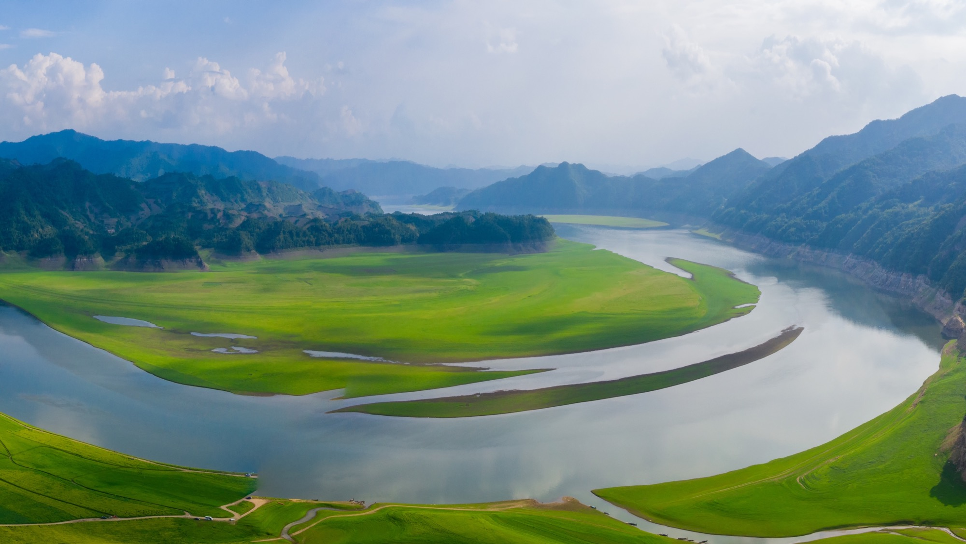
Economic and social value
Enhance the awareness of social public welfare
The expansibility of creative application
Users can keep abreast of the whereabouts of charity donations and understand the effectiveness of project in order to improve the credibility of public welfare organizations.
The achievement can be extended to other industries, such as agriculture, forestry, animal husbandry, fishery, manufacturing.
12

Slide 13
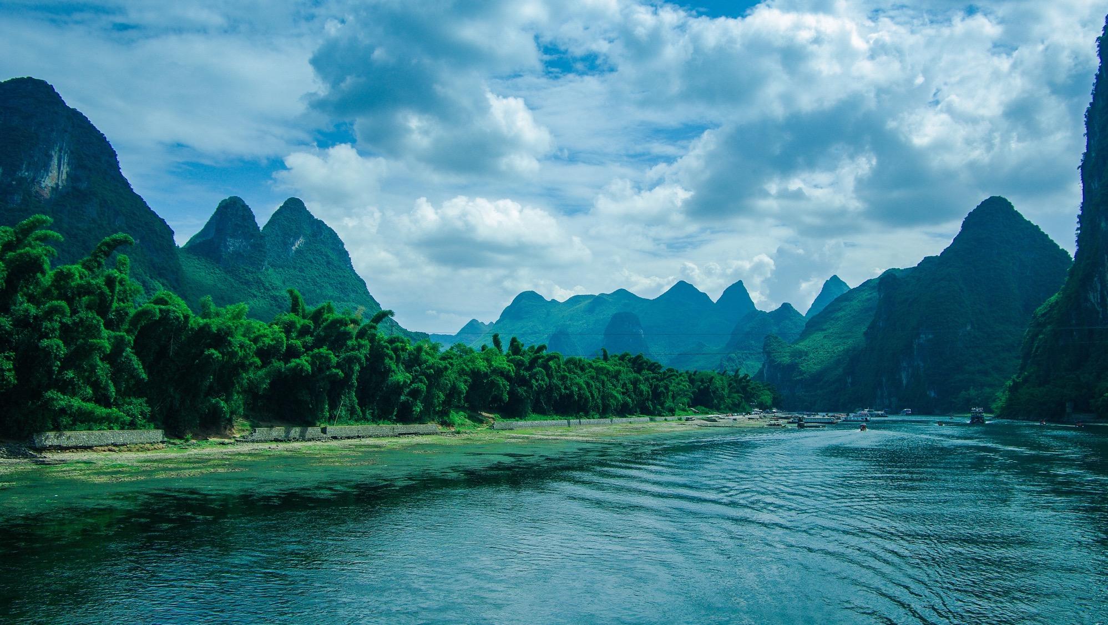
THANK YOU

